Slide 1



Intro to text mining using tm, openNLP , & topicmodels
www.linkedin.com/in/edwardkwartler
@tkwartler

Slide 2

Shameless Plug
Slated for May 2016
*cover art may change.

Slide 3
Agenda
What is Text Mining?
Keyword Scanning,
Cleaning
Freq Counts, Dendograms
Wordclouds
Topic Modeling
openNLP

Slide 4
What is Text Mining?
What is Text Mining?
Keyword Scanning,
Cleaning
Freq Counts, Dendograms
Wordclouds
Topic Modeling
openNLP

Slide 5
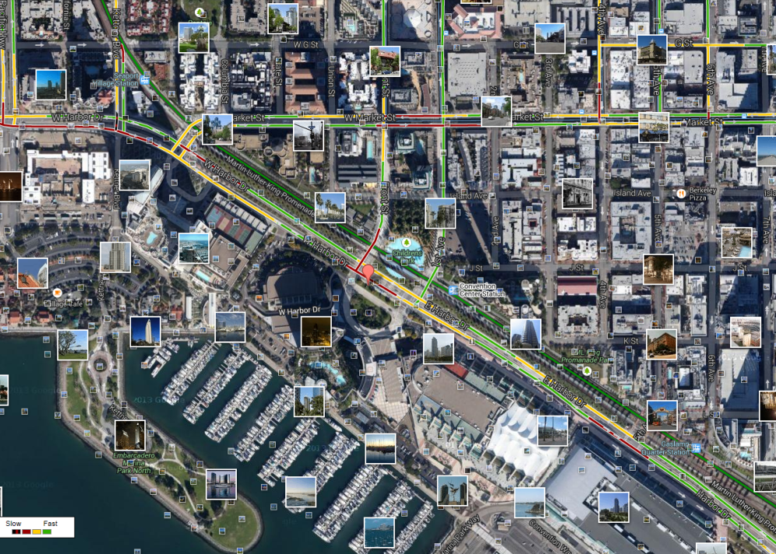
What is text mining?
Extract new insights from text
Let’s you drink from a fire hose of information
Language is hard; many unsolved problems
Unstructured
Expression is individualistic
Multi-language/cultural implications
Before Text Mining
What is Text Mining?

Slide 6
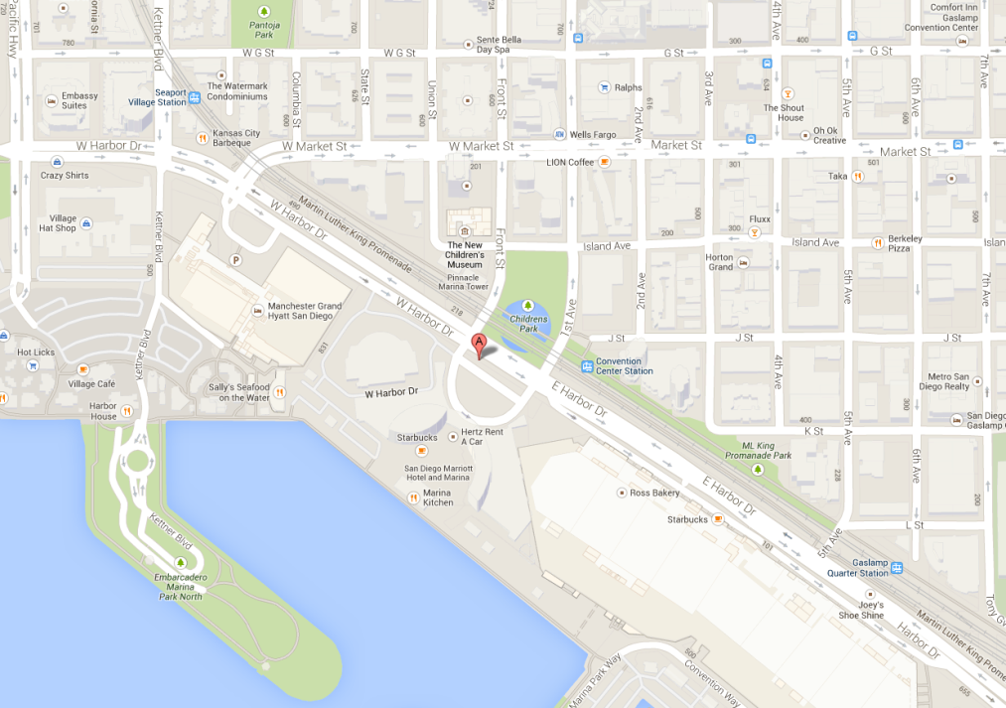
What is text mining?
Extract new insights from text
Let’s you drink from a fire hose of information
Language is hard; many unsolved problems
Unstructured
Expression is individualistic
Multi-language/cultural implications
After Text Mining
What is Text Mining?

Slide 7
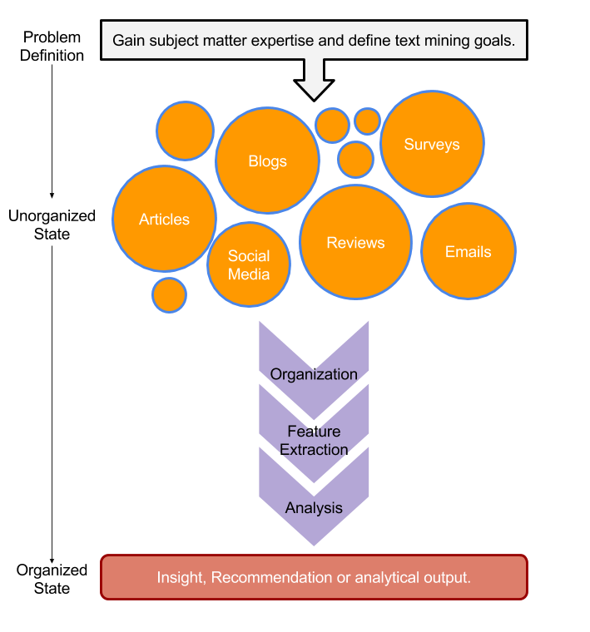
Text Mining Workflow
tweets
emails
surveys
Problem Definition
Identify Text Sources.
Text Organization
Feature Extraction
Analytics
Reach Insight/Recommendation
blogs
reviews
articles
What is Text Mining?

Slide 8

Text Mining Approaches
“Lebron James hit a tough shot.”
Semantic Using Syntactic Parsing
Bag of Words
Sentence
Noun Phrase
Verb Phrase
verb
Noun phrase
Lebron
a
James
article
adjective
noun
hit
tough
shot
Lebron James
hit
a
tough
shot
What is Text Mining?

Slide 9
Text Mining Approaches
Some Challenges in Text Mining
“I made her duck.”
Compound words (tokenization) changes meaning
“not bad” versus “bad”
Disambiguation
Sarcasm
“I like it…NOT!”
Cultural differences
“It’s wicked good” (in Boston)
I cooked waterfowl to eat.
I cooked waterfowl belonging to her.
I created the (clay?) duck and gave it to her.
Duck!!
What is Text Mining?

Slide 10





Text Sources
Text can be captured within the enterprise and elsewhere
Books
Electronic Docs (PDFs)
Blogs
Websites
Social Media
Customer Records
Customer Service Notes
Notes
Emails
…
The source and context of the medium is important. It will have a lot of impact on difficulty and data integrity.
What is Text Mining?

Slide 11
Enough of me talking…let’s do it for real!
Scripts in this workshop follow a simple workflow
Set the Working Directory
Load Libraries
Make Custom Functions & Specify Options
Read in Data & Pre-Process
Perform Analysis & Save
What is Text Mining?

Slide 12
Enough of me talking…let’s do it for real!
Setup
Install R/R Studio
Download scripts and data, save to a desktop folder & unzip
https://goo.gl/CYfe33
http://www.rstudio.com/products/rstudio/download/
http://cran.us.r-project.org/
Install Packages
Run “1_Install_Packages.R” script
An error may occur if the Java version doesn’t match
I have tested these scripts on R 3.1.2 with a Mac.
Some steps may be different in other environments.
What is Text Mining?

Slide 13
Warning: Twitter Profanity
Twitter demographics skew young and as a result have profanity that appear in the examples.
It’s the easiest place to get a lot of messy text fast, if it is offensive feel free to talk to me and I will work to get you other texts for use on your own. No offense is intended.
#%@*!!!

Slide 14
Keyword Scanning, Cleaning & Freq Counts
What is Text Mining?
Keyword Scanning,
Cleaning
Freq Counts, Dendograms
Wordclouds
Topic Modeling
openNLP

Slide 15
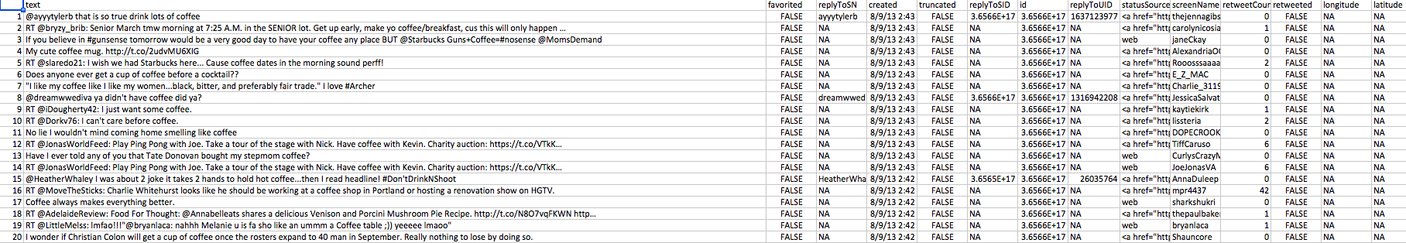
Open the “coffee.csv” to get familiar with the data structure
1000 tweets mentioning “coffee”
Setup
“text$text”
is the vector of tweets that we are interested in.
All other attributes are auto generated from the twitter API
Keyword scanning, Cleaning & Freq Counts

Slide 16
Open 2_Keywod_Scanning.R
SET YOUR WORKING DIRECTORY
Remember your slashes
Save it so you won’t have to do it again

Slide 17
2_Keyword_Scanning.R
Basic R Unix Commands
Setup
grepl returns a vector of T/F if the pattern is present at least once
grepl(“pattern”, searchable object, ignore.case=TRUE)
grep returns the position of the pattern in the document
grep(“pattern”, searchable object, ignore.case=TRUE)
“library(stringi)” Functions
stri_count counts the number of patterns in a document
stri_count(searchable object, fixed=“pattern”)
Keyword scanning, Cleaning & Freq Counts

Slide 18
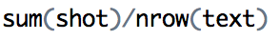
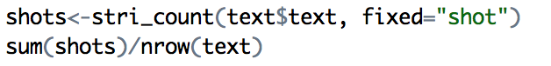
2_Keyword_Scanning.R
Let’s try to scan for other words in our other corpora.
Setup
Change the read.csv file to another corpus.
Change the search patterns to understand the result.
Examples
Keyword scanning, Cleaning & Freq Counts

Slide 19
Remember This?
tweets
emails
surveys
blogs
reviews
articles
What is Text Mining?

Slide 20
R for our Cleaning Steps
Setup
Tomorrow I’m going to have a nice glass of Chardonnay and wind down with a good book in the corner of the county :-)
tweets
emails
Remove Punctuation
Remove extra white space
Remove Numbers
Make Lower Case
Remove “stop” words
blogs
reviews
articles
tomorrow going nice glass chardonnay wind down good book corner county
Keyword scanning, Cleaning & Freq Counts

Slide 21
Open 3_Cleaning and Frequency Counts.R
SET YOUR WORKING DIRECTORY
Remember your slashes
Save it so you won’t have to do it again

Slide 22
3_Cleaning and Frequency Count.R
“library(tm)” Functions
VCorpus creates a corpus held in memory.
Setup
VCorpus(source)
tm_map applies the transformations for the cleaning
tm_map(corpus, function)
getTransformations() will list all standard tm corpus transformations
We can apply standard R ones too. Sometimes it makes sense to perform all of these or a subset or even other transformations not listed like “stemming”
tm_map(corpus, removePunctuation) - removes the punctuation from the documents
tm_map(corpus, stripWhitespace) - extra spaces, tabs are removed
tm_map(corpus, removeNumbers) - removes numbers
tm_map(corpus, tolower) – makes all case lower
tm_map(corpus, removeWords) - removes specific “stopwords”
New Text Mining Concepts
Corpus- A collection of documents that analysis will be based on.
Stopwords – are common words that provide very little insight, often articles like “a”, “the”. Customizing them is sometimes key in order to extract valuable insights.
Keyword scanning, Cleaning & Freq Counts

Slide 23
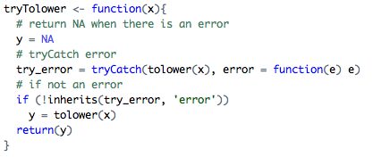
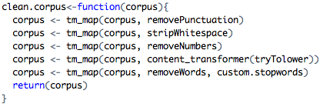
3_Cleaning and Frequency Count.R
“tryTolower”is poached to account for errors when making lowercase.
Setup
“clean.corpus” makes applying all transformations easier.
“custom.stopwords” combines vectors of words to remove from the corpus
“custom.reader” keeps the meta data (tweet ID) with the original document
Keyword scanning, Cleaning & Freq Counts

Slide 24
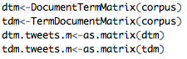
3_Cleaning and Frequency Count.R
Bag of Words means creating a Term Document Matrix or Document Term Matrix*
Term Document Matrix
Setup
Document Term Matrix
 | Tweet1 | Tweet2 | Tweet3 | Tweet4 | … | Tweet_n
Term1 | 0 | 0 | 0 | 0 | 0 | 0
Term2 | 1 | 1 | 0 | 0 | 0 | 0
Term3 | 1 | 0 | 0 | 2 | 0 | 0
… | 0 | 0 | 3 | 0 | 1 | 1
Term_n | 0 | 0 | 0 | 1 | 1 | 0
 | Term1 | Term2 | Term3 | … | Term_n
Tweet1 | 0 | 1 | 1 | 0 | 0
Tweet2 | 0 | 1 | 0 | 0 | 0
Tweet3 | 0 | 0 | 0 | 3 | 0
… | 0 | 0 | 0 | 1 | 1
Tweet_n | 0 | 0 | 0 | 1 | 0
“as.matrix” makes the tm’s version of a matrix into a simpler version
These matrices are often very sparse and large therefore some special steps may be needed and will be covered in subsequent scripts.
*Depends on analysis, both are transpositions of the other
Keyword scanning, Cleaning & Freq Counts

Slide 25
Dendograms & Wordclouds
What is Text Mining?
Keyword Scanning,
Cleaning
Freq Counts, Dendograms
Wordclouds
Topic Modeling
openNLP

Slide 26
Open 4_Dendograms.R
SET YOUR WORKING DIRECTORY
Remember your slashes
Save it so you won’t have to do it again

Slide 27
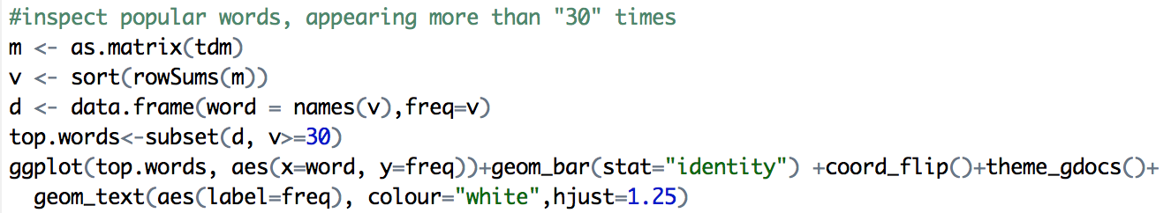
4_Dendogram.R script builds on the matrices
First let’s explore simple frequencies
Setup
Adjust v>=30 to limit the number of words in the “d” dataframe. This will make the visual look better.
You can also write.csv(d,”frequent_terms.csv”) if you want to export the data frame.
Freq Counts, Dendograms
Wordclouds

Slide 28
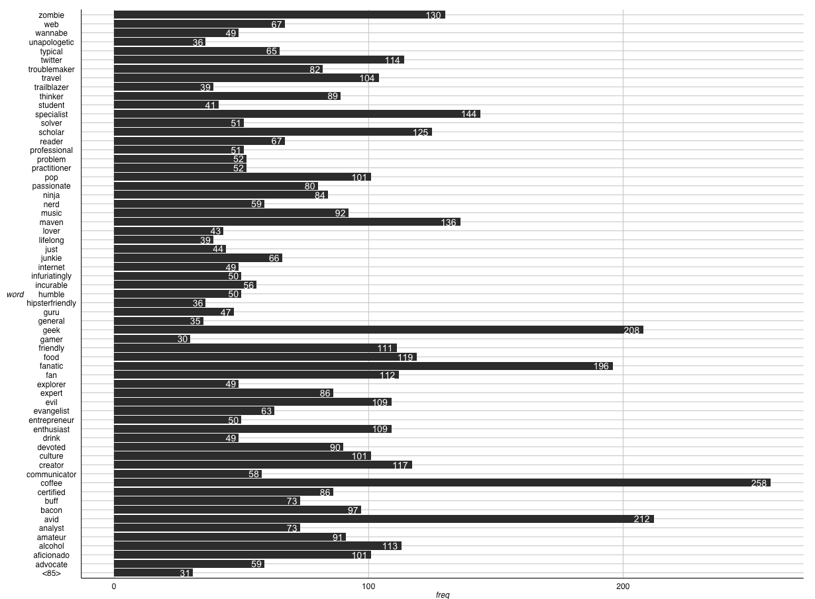
4_Dendogram.R script
“zombie” is an unexpected, highly frequent term. Let’s explore it.
Setup
Freq Counts, Dendograms
Wordclouds

Slide 29
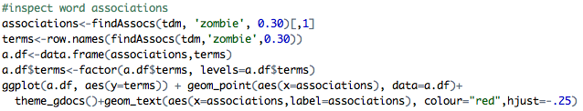
4_Dendogram.R script
Setup
Next let’s explore word associations, similar to correlation
Adjust 0.30 to get the terms that are associated .30 or more with the ‘zombie’ term.
Make sure the 0.30s are the same for both in order to make the dataframe which is plotted.
Treating the terms as factors lets ggplot2 sort them for a cleaner look.
Freq Counts, Dendograms
Wordclouds

Slide 30
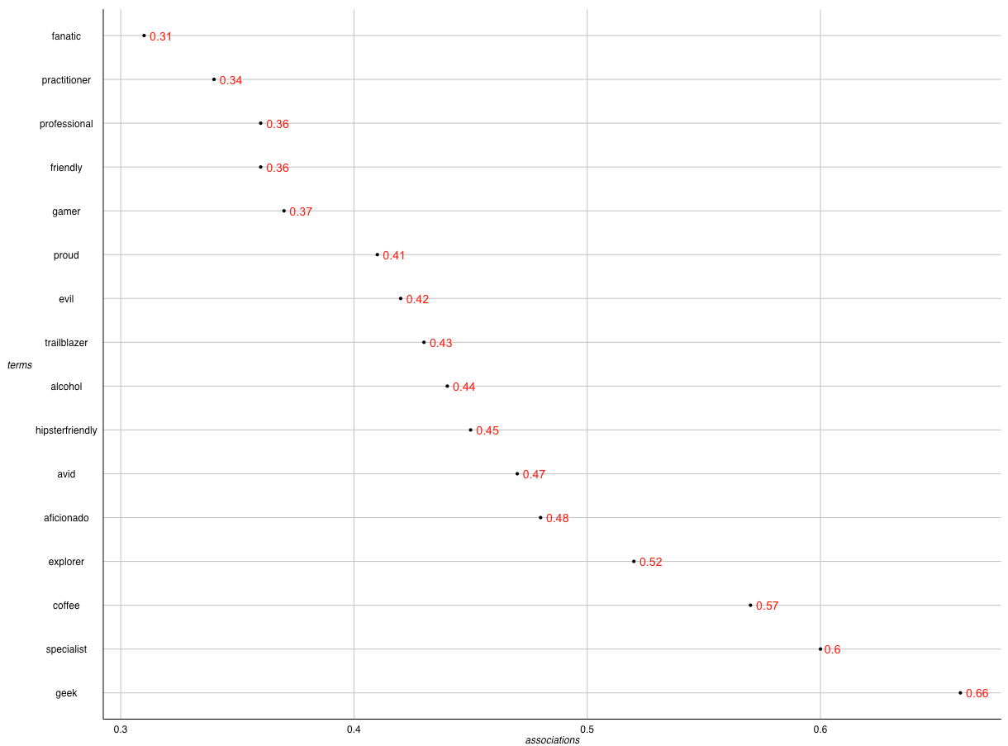
4_Dendogram.R script
“geek” has the highest word association with “zombie”.
Setup
Unapologetic thinker. Lifelong beer scholar. Incurable zombie fanatic. Explorer. Tvaholic.
Alcohol geek. Avid tv buff. Friendly beer aficionado. Coffee guru. Zombie junkie.
Freq Counts, Dendograms
Wordclouds

Slide 31
Extracting Meaning using Dendograms
Dendograms are hierarchical clusters based on frequencies.
Reduces information much like average is a reduction of many observations’ values
Word clusters emerge often showing related terms
Term frequency is used to construct the word cluster. Put another way, term A and term B have similar frequencies in the matrix so they are considered a cluster.
Setup
63
City | Annual Rainfall
Portland | 43.5
Boston | 43.8
New Orleans | 62.7
44
New Orleans
Boston & Portland are a cluster at height 44. You lose some of the exact rainfall amount in order to cluster them.
Boston
Portland
Freq Counts, Dendograms
Wordclouds

Slide 32
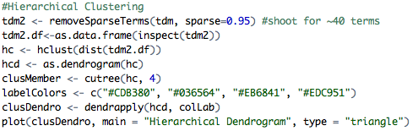
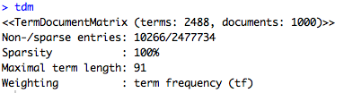
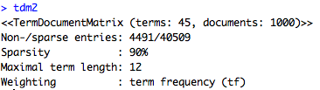
4_Dendogram.R script
Weird associations! Maybe a dendogram will help us more
Setup
Adjust the sparse parameter to have ~40 to 50 terms in order to have a visually appealing dendogram.
New Text Mining Concept
Sparse- Term Document Matrices are often extremely sparse. This means that any document (column) has mostly zero’s. Reducing the dimensions of these matrices is possible by specifying a sparse cutoff parameter. Higher sparse parameter will bring in more terms.
Freq Counts, Dendograms
Wordclouds

Slide 33
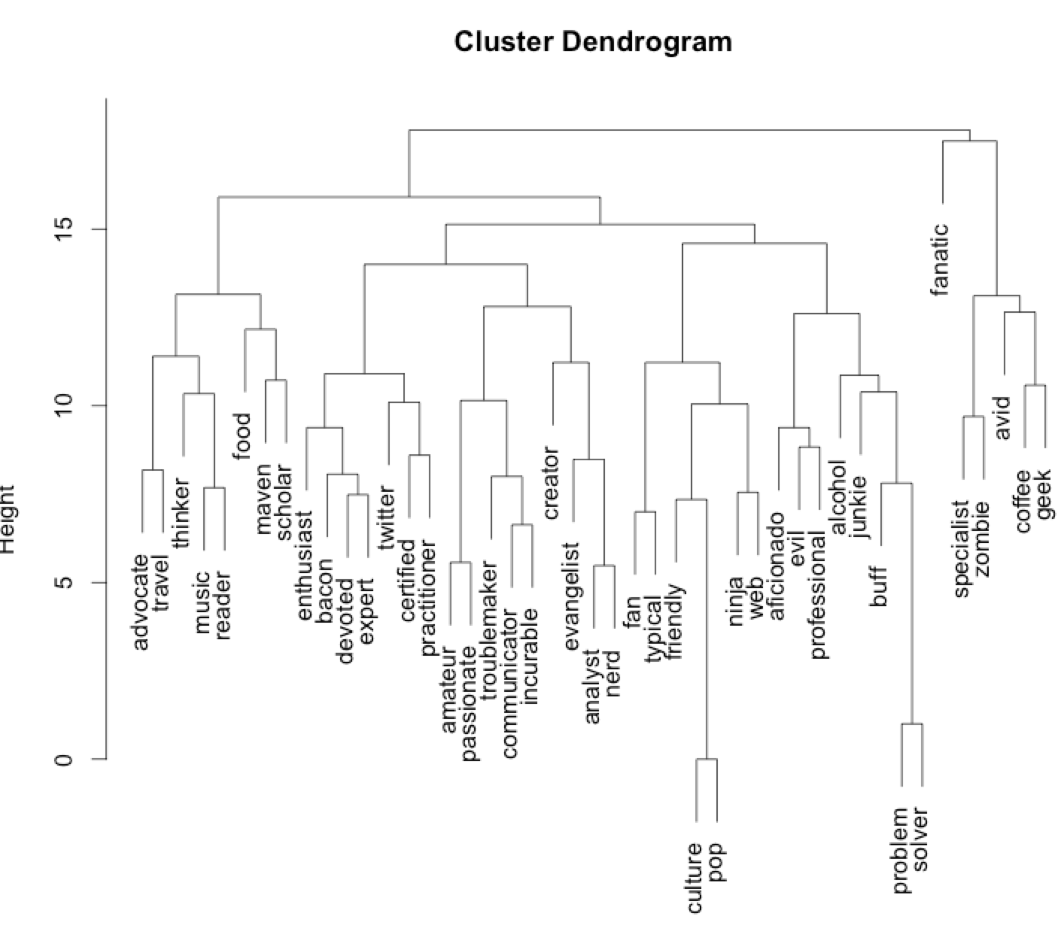
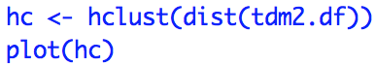
4_Dendogram.R script
Base Plot of a Dendogram
Setup
Less visually appealing
Clusters can be hard to read given the different heights
Freq Counts, Dendograms
Wordclouds

Slide 34
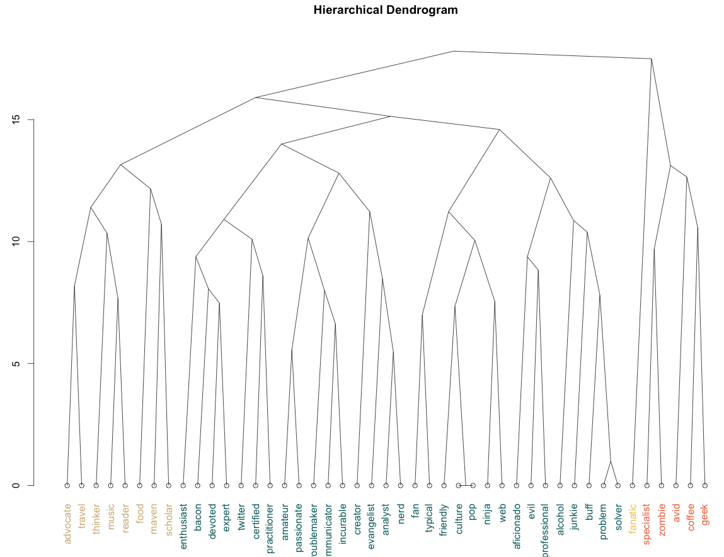
4_Dendogram.R script
Aesthetically my choice is to have colored clusters and all terms at the bottom.
Freq Counts, Dendograms
Wordclouds

Slide 35
4_Dendogram.R
Let’s review other corpora.
Setup
Change the read.csv file to another corpus.
Construct the ggplot frequency visual.
Construct the ggplot word association for a term you see in the frequency visual.
Create a dendogram with ~40 to 50 terms to see how it clusters.
Keyword scanning, Cleaning & Freq Counts

Slide 36
Open 5_Simple_Wordcloud.R
SET YOUR WORKING DIRECTORY
Remember your slashes
Save it so you won’t have to do it again

Slide 37
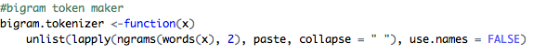
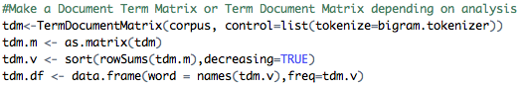
5_Simple_Wordcloud.R script
New Text Mining Concept
Tokenization- So far we have created single word n-grams. We can create multi word “tokens” like bigrams, or trigrams with this line function. It is applied when making the term document matrix.
Freq Counts, Dendograms
Wordclouds

Slide 38
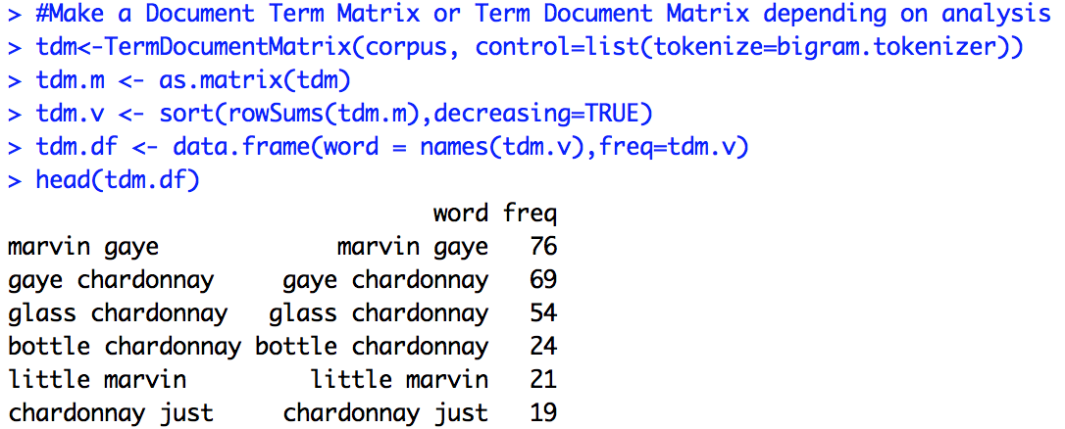
5_Simple_Wordcloud.R script
To make a wordcloud we follow the previous steps and create a data frame with the word and the frequency.
Freq Counts, Dendograms
Wordclouds

Slide 39
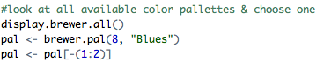
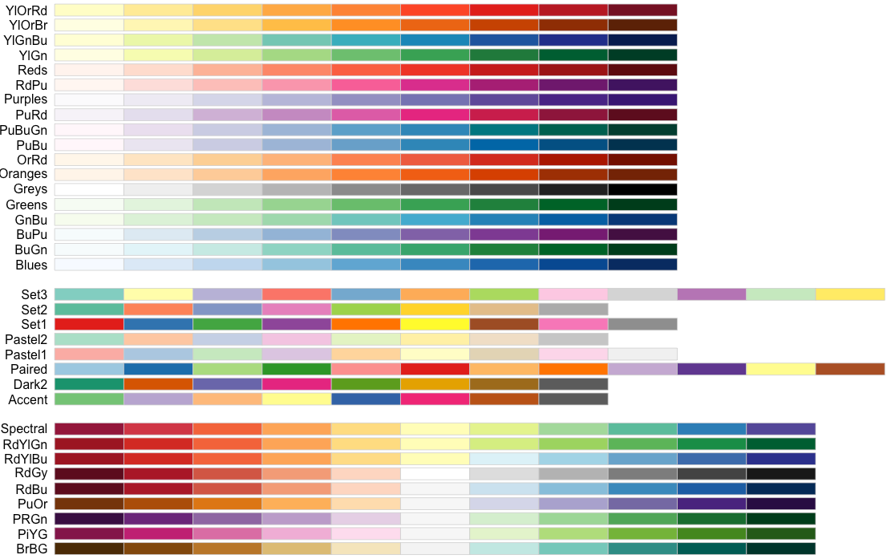
5_Simple_Wordcloud.R script
Next we need to select the colors for the wordcloud.
Freq Counts, Dendograms
Wordclouds

Slide 40
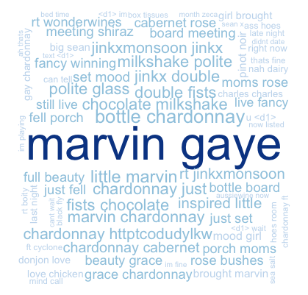
5_Simple_Wordcloud.R script
Bigram Tokenization has captured “marvin gaye”, “bottle (of) chardonnay”, “chocolate milkshake” etc.
A word cloud is a frequency visualization. The larger the term (or bigram here) the more frequent the term.
You may get warnings if certain tokens are to large to be plotted in the graphics device.
Freq Counts, Dendograms
Wordclouds

Slide 41
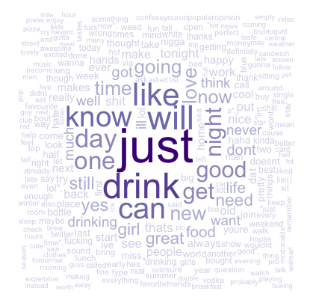
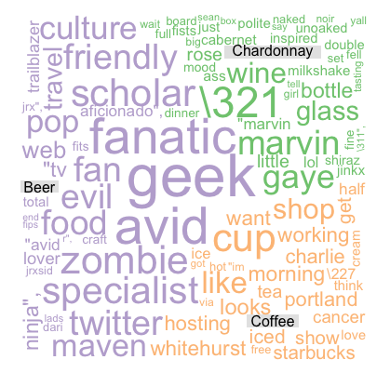
Types of Wordclouds
Single Corpus
Multiple Corpora
wordcloud( )
comparison.cloud( )
commonality.cloud( )
comparison.cloud( )
*this wc has 3 corpora although the Venn diagram only shows 2 as an example.
Freq Counts, Dendograms
Wordclouds

Slide 42
Open 6_Other_Wordclouds.R
SET YOUR WORKING DIRECTORY
Remember your slashes
Save it so you won’t have to do it again

Slide 43
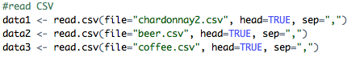
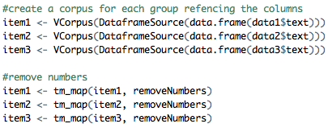
6_Other_Wordcloud.R
Bring in more than one corpora.
Apply each transformation separately…more in script.
Be sure to label the columns in the same order as was brought in.
Freq Counts, Dendograms
Wordclouds

Slide 44
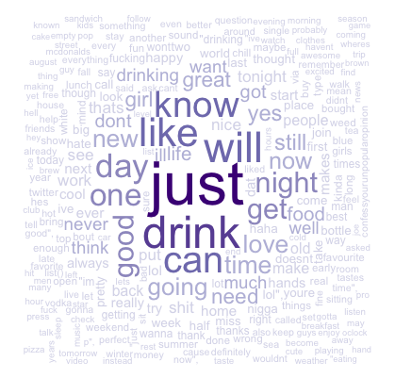
Commonality Cloud
The tweets mentioning “chardonnay” “beer”, and “coffee” have these words in common.
Again size is related to frequency.
Not helpful in this example as we already knew these were “drinks” but in diverse corpora it may be more helpful e.g. political speeches.
Freq Counts, Dendograms
Wordclouds

Slide 45
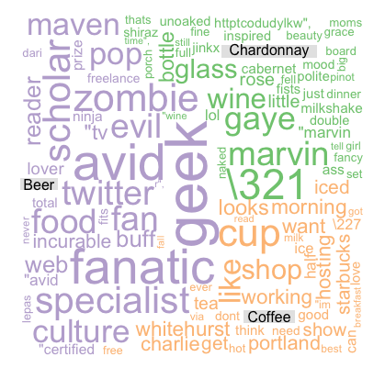
Commonality Cloud
The tweets mentioning “chardonnay” “beer”, and “coffee” have these dissimilar words.
Again size is related to frequency.
Beer drinkers in this snapshot are passionate (fanatics, geeks, specialists) on various subjects while Chardonnay drinkers mention Marvin Gaye. Coffee mentions mention morning cup and work.
Freq Counts, Dendograms
Wordclouds

Slide 46
Word Cloud Practice
Try your hand at using tequila in the word clouds
Remember to adjust your stop words!
Freq Counts, Dendograms
Wordclouds

Slide 47
Agenda
What is Text Mining?
Keyword Scanning,
Cleaning
Freq Counts, Dendograms
Wordclouds
Topic Modeling
openNLP

Slide 48
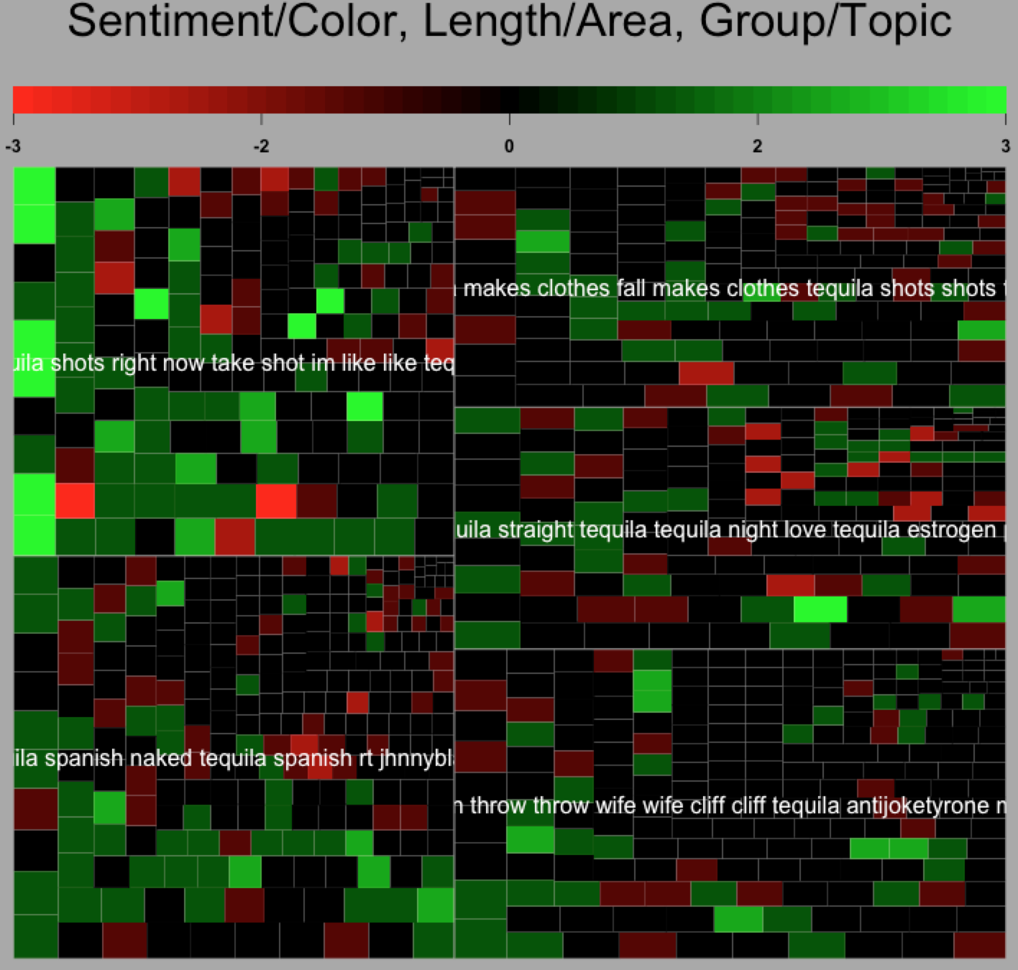
7_Topic_Modeling_Sentiment.R
TREEMAP: multi dimensional representation of the corpus attributes.
Setup
Color will represent quick, simple sentiment
Each tweet is a small square
The area of the tweet’s square is related to the number of terms in the tweet, document length
The larger grouping is based on LDA or CTM Topic Modeling
End result is understanding broad topics, their sentiment and amount of the corpus documents devoted to the identified topic.
Topic Modeling
openNLP

Slide 49
First, simple Sentiment Polarity
Scoring
Zipf’s Law
Surprise is a sentiment.
Hit by a bus! – Negative Polarity
Won the lottery!- Positive Polarity
Many words in natural language but there is steep decline in everyday usage. Follows a predictable pattern.
I loathe BestBuy Service -1
I love BestBuy Service. They are the best. +2
I like shopping at BestBuy but hate traffic. 0
R’s QDAP polarity function scans for positive words, and negative words as defined by MQPA Academic Lexicon research. It adds positive words and subtracts negative ones. The final score represents the polarity of the social interaction.

Slide 50
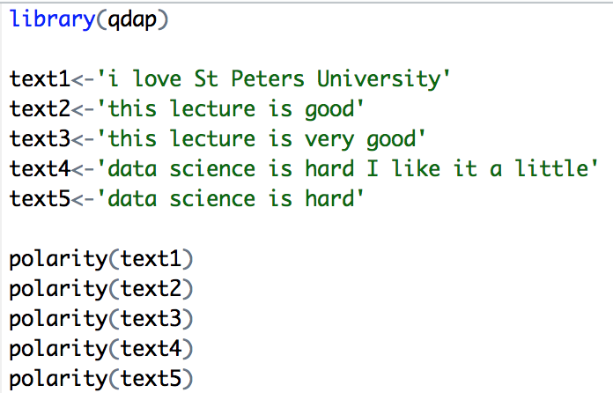
First, simple Sentiment Polarity
Scoring
In text 1, “love” was identified as positive. The text has 5 words and
so 1/sqrt(5) = .447
In text 2, “good” was identified positively. So 1/sqrt(4)=.5
In text 3, “good” was found along with the amplifier “very”.
So (.8+1)/sqrt(5)=.805
In text 4, hard and like cancel each other out so the polarity is zero. 1-1/sqrt(9=0
In text 5 “hard” is -1/sqrt(4)=-.50
First it looks for the polarized word. Then identifies valence shifters (default 4 words before and two words after) Amplifiers are assigned +.8 and de-amplifiers weight is constrained to -1.

Slide 51
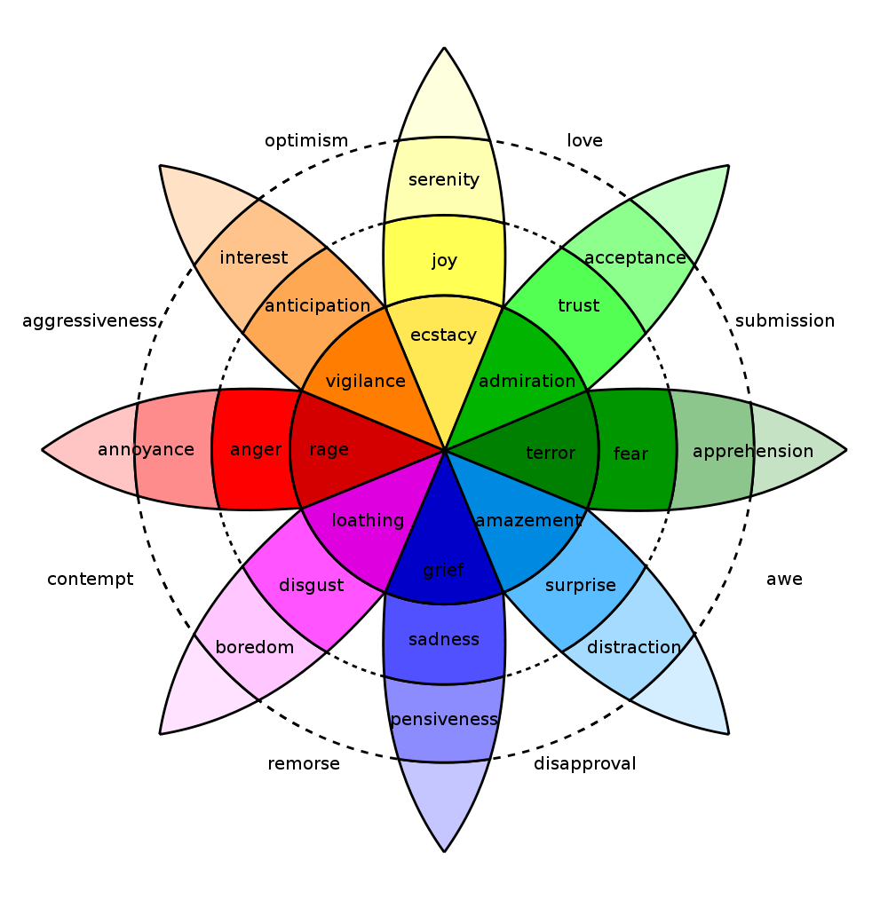
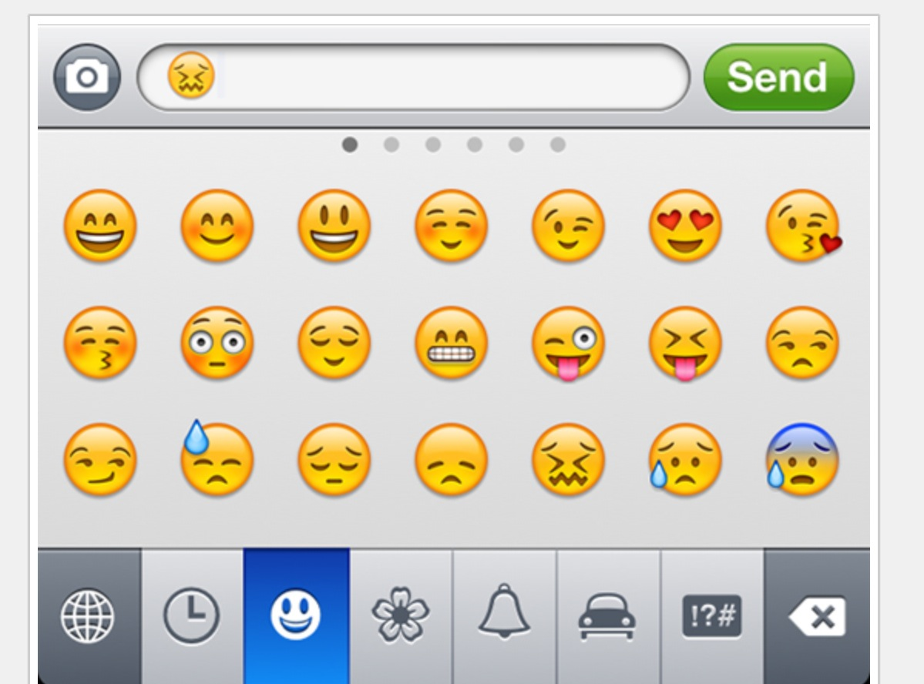
In reality sentiment is more complex.
Countless Emoji
Plutchik’s Wheel

Slide 52
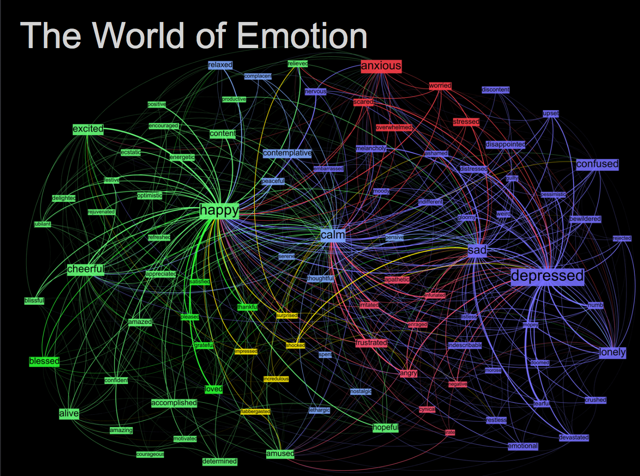
Kanjoya’s Experience Corpus

Slide 53
Second, LDA (Latent Dirichlet Allocation) Topic Modeling
LDA
Example
Each document is made up of mini topics.
Corpus
I like to watch basketball and football on TV.
I watched basketball and Shark Tank yesterday.
Open source analytics software is the best.
R is an open source software for analysis.
I use R for basketball analytics.
Probability is assigned to each document (tweet) for the specific observed topics.
A document can have varying probabilities of topics simultaneously.
LDA Topics
Topic A: 30% basketball, 20% football, 15% watched, 10% TV…something to do with watching sports
Topic B: 40% software, 10% open, 10% source…10% analytics something to do with open source analytics software
Technical Explanations:
http://en.wikipedia.org/wiki/Latent_Dirichlet_allocation
http://cs.brown.edu/courses/csci2950-p/spring2010/lectures/2010-03-03_santhanam.pdf
*Full disclosure I am still learning this methodology
Documents
100% Topic A
100% Topic A
100% Topic B
100% Topic B
60% Topic B, 40% Topic A

Slide 54
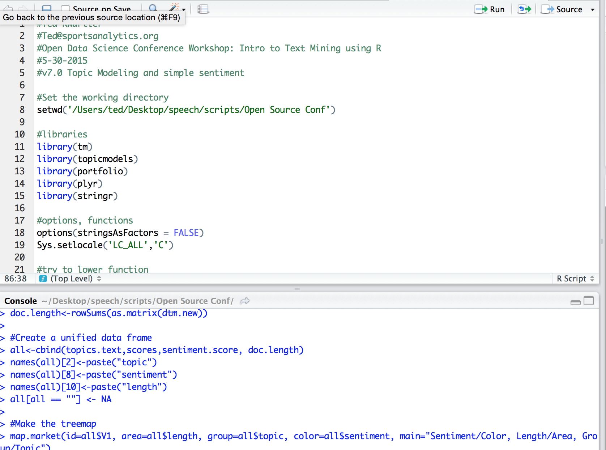
7_Topic_Modeling_Sentiment.R
Open the script and let’s walk through it line by line because there are multiple additions to the previous scripts
Setup
Can you try to make the same visual with the coffee corpus?
Topic Modeling
openNLP

Slide 55
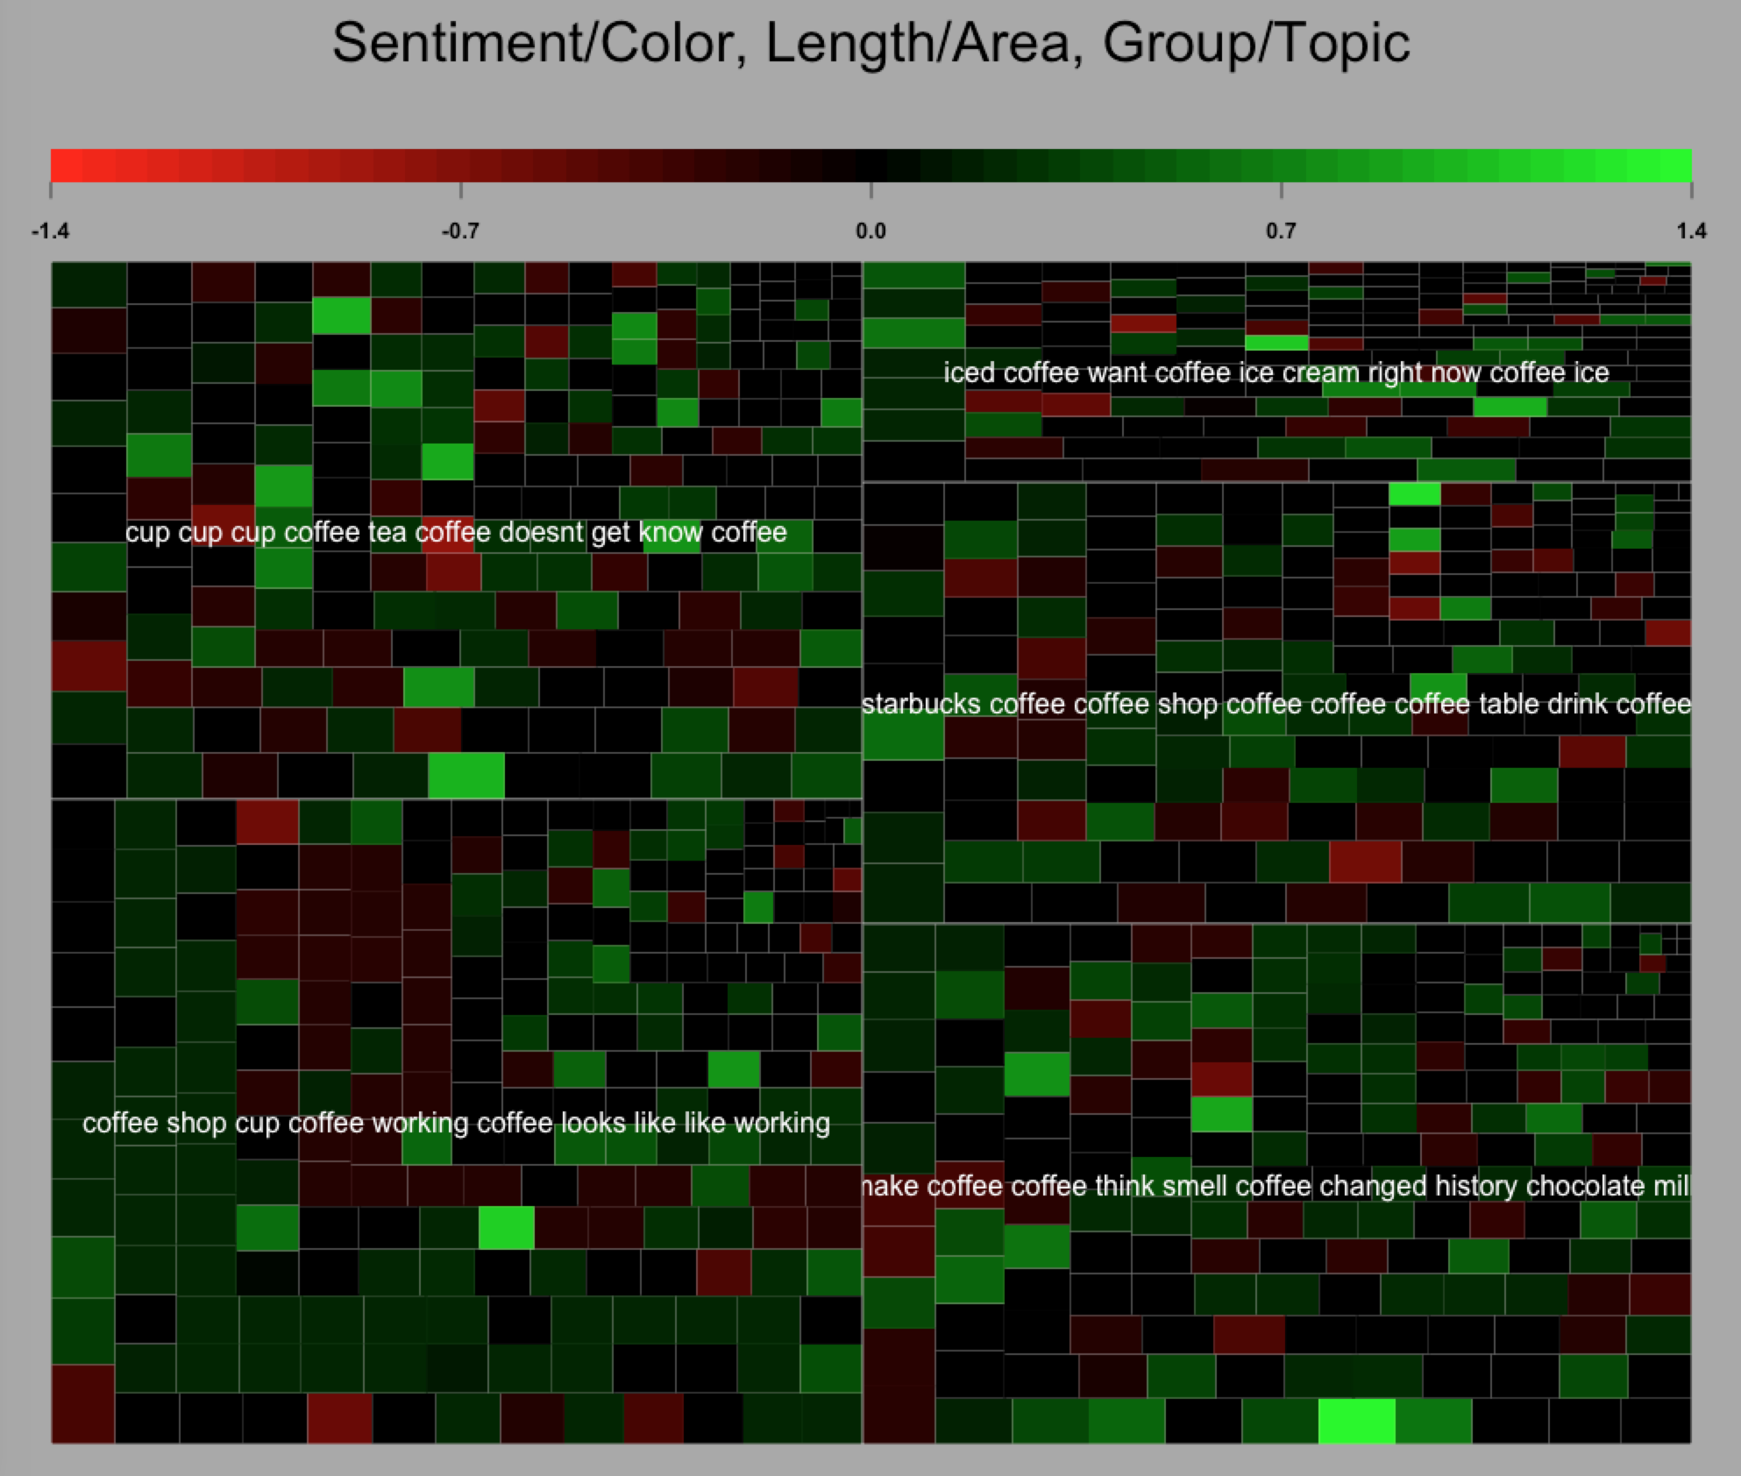
7_Topic_Modeling_Sentiment.R
Coffee Treemap
Setup
Topic Modeling
openNLP

Slide 56
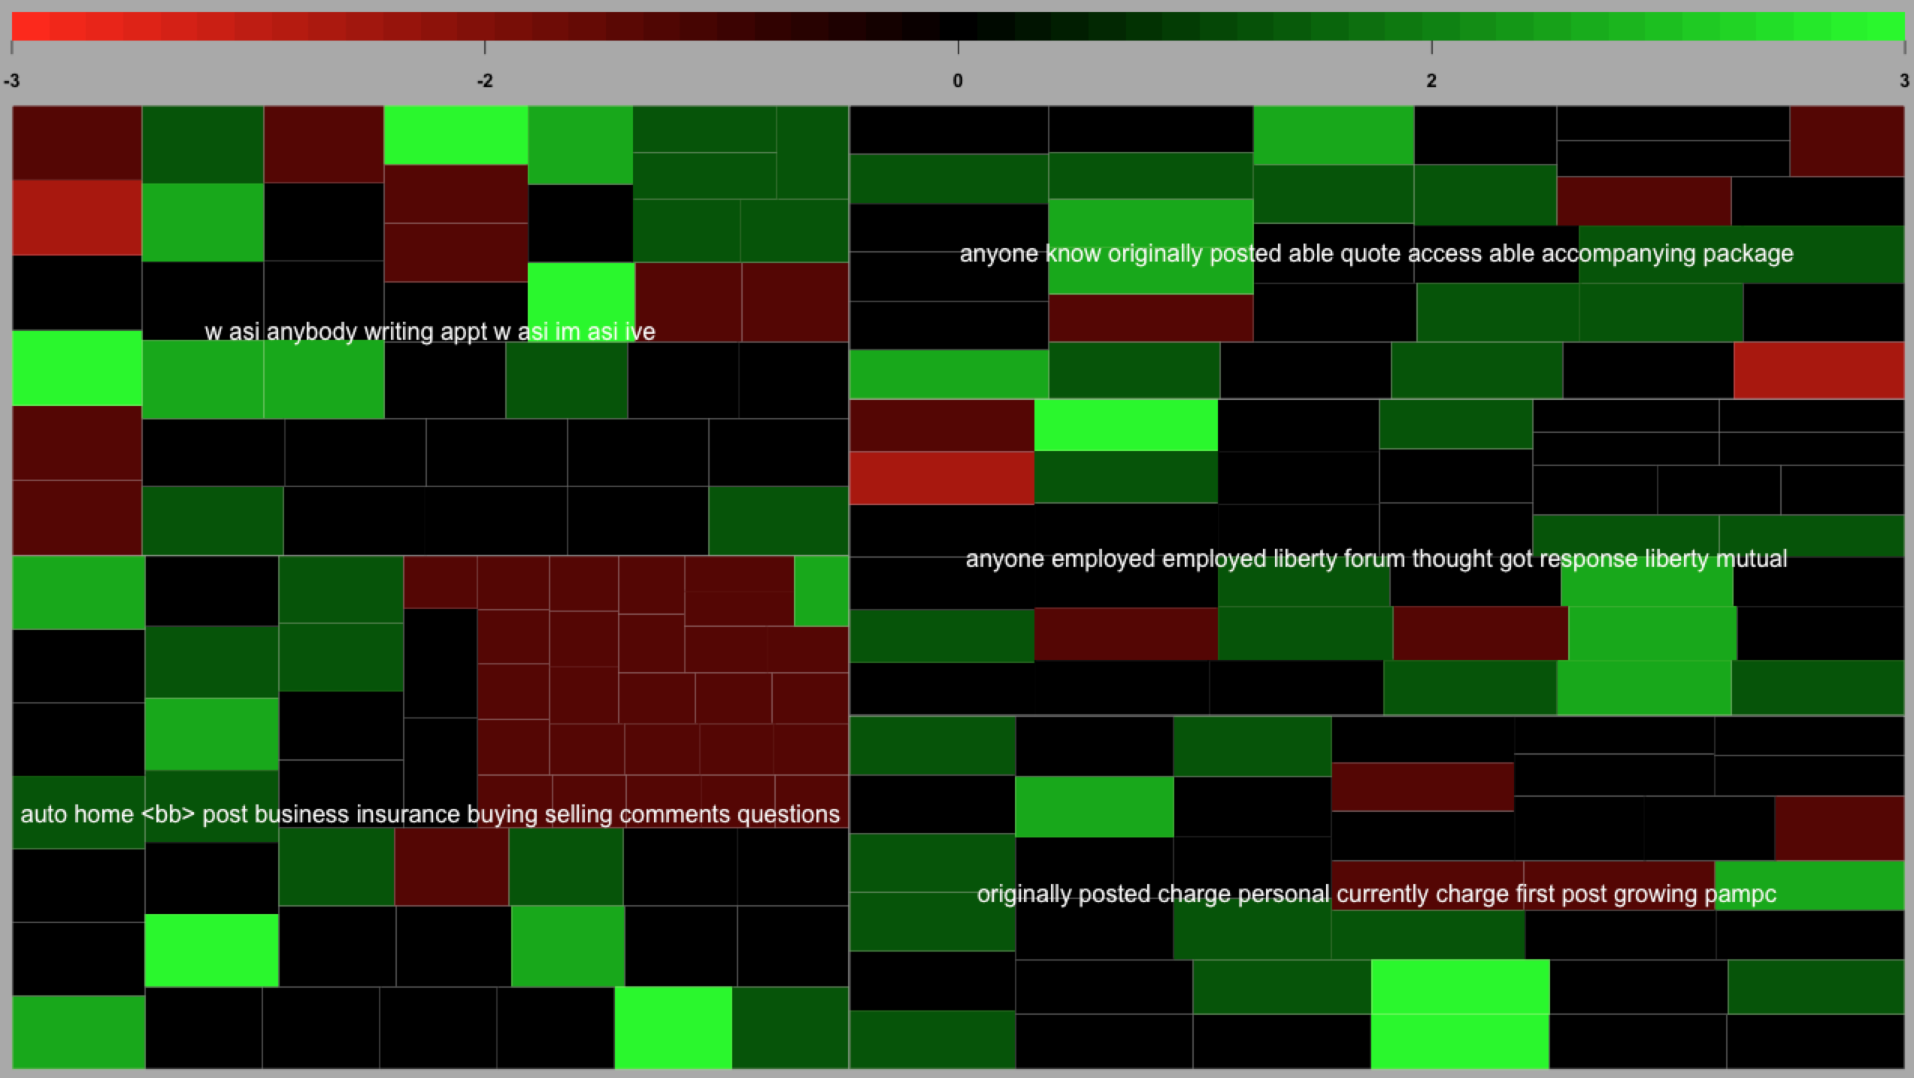
7_Topic_Modeling_Sentiment.R
Insurance Forum Treemap shows a wider topic sentiment and length range.
Setup
Topic Modeling
openNLP

Slide 57
Remember this?
“Lebron James hit a tough shot.”
Semantic Using Syntactic Parsing
Bag of Words
Sentence
Noun Phrase
Verb Phrase
verb
Noun phrase
Lebron
a
James
article
adjective
noun
hit
tough
shot
Lebron James
hit
a
tough
shot
What is Text Mining?

Slide 58
8_Open_Language_Processing.R
library(openNLP)
Setup
https://rpubs.com/lmullen/nlp-chapter
Uses Annotators to identify the specific item in the corpus. Then holds all annotations in a plain text document. Think of auto-tagging words in a document and saving the document terms paired with the tag.
Documentation, examples are hard to come by!
Annotations
Grammatical or POS (Part of Speech) Tagging
Sentence Tagging
Word Tagging
Named Entity Recognition
Persons
Locations
Organizations
Topic Modeling
openNLP

Slide 59
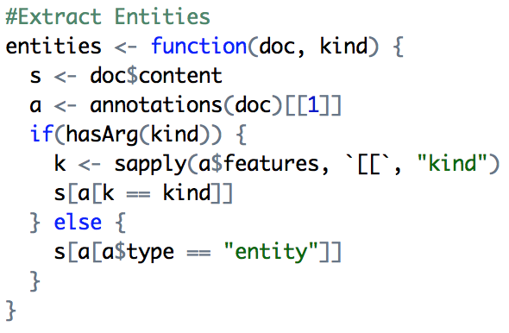
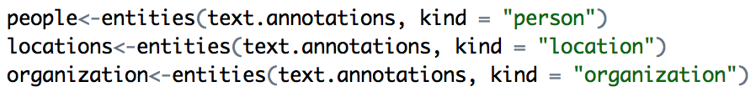
8_Open_Language_Processing.R
Setup
The annotated plain text object is large with a complex structure. This function allows us to extract the named entities.
Topic Modeling
openNLP

Slide 60
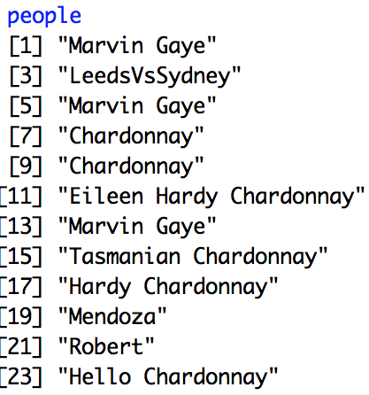
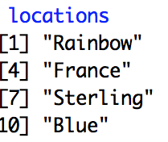
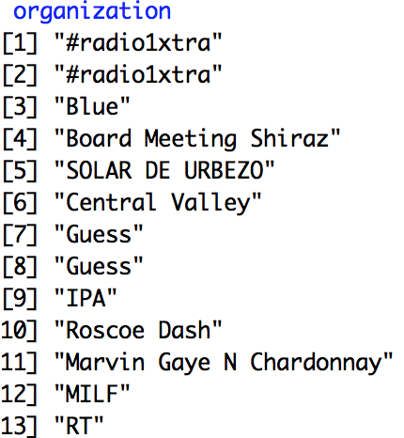
8_Open_Language_Processing.R
Setup
Topic Modeling
openNLP

Slide 61
Questions?
@tkwartler
www.linkedin.com/in/edwardkwartler

